Slide 3
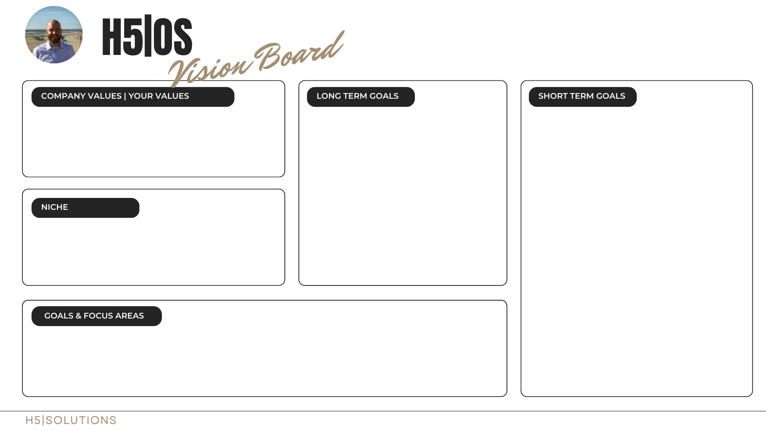
Every day is day 1 (check – do –act)
Automate – eliminate – delegate tasks
Simplify
Optimize
Think big!
Serve a country or region in a global operating company
Manage to serve 50k professionals & founders through an app/SaaS solution?
Community or network of key stakeholders
As a professional: Global visibility in a global company
As a founder: Email list at 50k
Get your Saas,
Newsletter,
Community,
Knowledge sharing solutions
up and running
Identify what you love / have a passion for
What you love, you are good at
Build a team / community around you
Dream & inspire
Build a system
Identify your target audience – Solopreneurs and entrepreneurs seeking their North Star.
Consider what is unique about your approach: How do you stand out? This could be through simplifying processes, utilizing specific tools, or providing particular services such as newsletters, communities, and other communication channels. Implement processes using app solutions, SaaS platforms, and knowledge platforms.

Slide 4
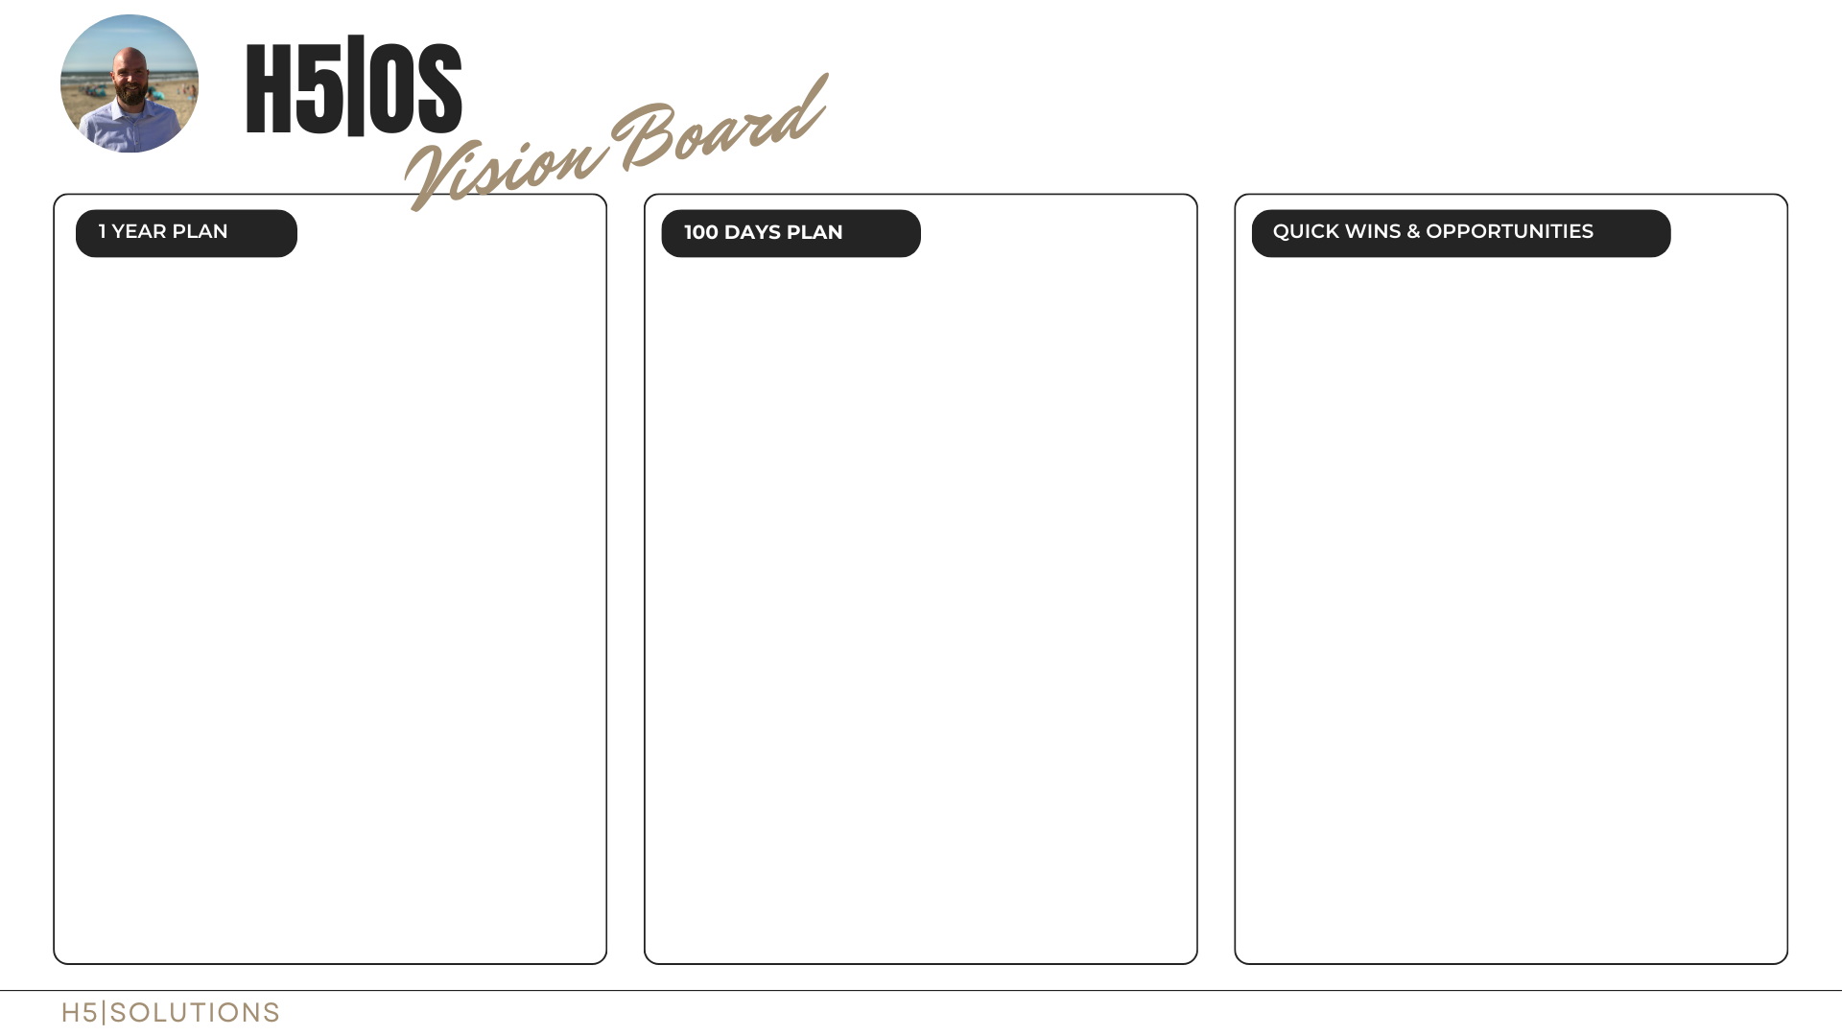
What does success look like in 1 year from now?
Be…
Specific
Measurable
Achievable
Realistic
timebound
What does success look like in 100 days from now?
Be…
Specific
Measurable
Achievable
Realistic
timebound
Think about your specific situation.
COMPANY
Hire
Train
Optimize
PROFESSIONAL | INDIVIDUAL
Gap analyzes
Gap filling
Optimize
Long hanging fruits
Minimize risks | prioritize
Eliminate tasks | delegate

Slide 12
Where do you see the company | yourself in 10 years from now?
Be…
Specific
Measurable
Achievable
Realistic
timebound

Slide 13
Where do you see the company | yourself in 5 years from now?
Be…
Specific
Measurable
Achievable
Realistic
timebound

Slide 14
Where do you see the company | yourself in 3 years from now?
Be…
Specific
Measurable
Achievable
Realistic
timebound

Slide 15
Where do you see the company | yourself in 1 years from now?
Be…
Specific
Measurable
Achievable
Realistic
timebound

Slide 16
Where do you see the company | yourself in 100 days from now?
Be…
Specific
Measurable
Achievable
Realistic
timebound

Slide 17
Think about your specific situation.
COMPANY
Hire
Train
Optimize
PROFESSIONAL | INDIVIDUAL
Gap analyzes
Gap filling
Optimize
Long hanging fruits
Minimize risks | prioritize
Eliminate tasks | delegate

Slide 18
ANDREAS PROFILE
H5|PULSE

